Slide 1
Get to the Point!
Write effective scenes, characterization, conflict, plot, and more with clustering.

Slide 2
Words, where are my words?
This is crap!
I should check my sales.
I have no hook!
What’s a hook?
What is my premise?
Who am I kidding? I am not a writer
I need more coffee.

Slide 3
What is the point??

Slide 4
Inner Editor
ID 4942853 © Lane Erickson
| Dreamstime.com

Slide 5
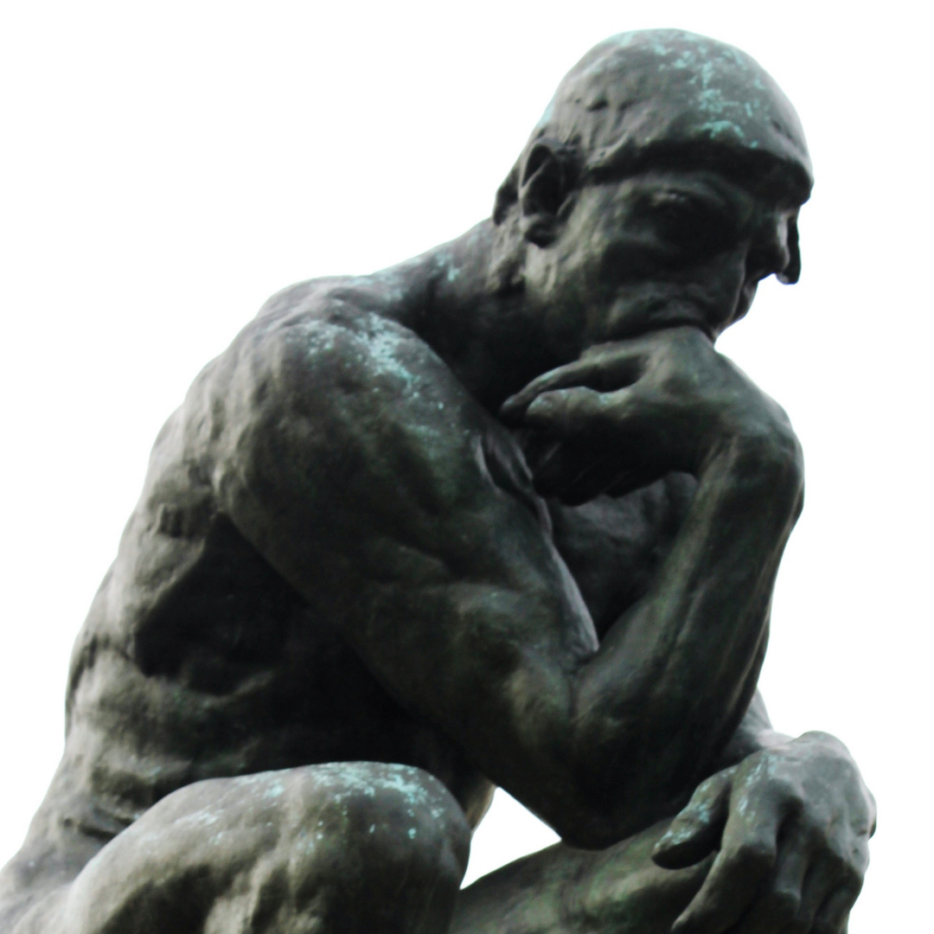
Thinking, Thinking, Thinking

Slide 6
Oh No!

Slide 7
What is clustering?
What can be done with clustering?
Why does it work for me?
Cluster:
Scene Goals
Vignettes
Taglines
Emails
Poetry

Slide 8
What is Clustering?
It is a brainstorming tool that quiets the inner censor and engages the creative aspect of the brain, effortlessly. It helps bridge the right and left sides of the brain to enrich your writing and clarify its importance. No matter what level of writer you consider yourself—beginning or experienced – you can boost your writing’s effectiveness and creativity with clustering.

Slide 9
What can be done with Clustering?
I use clustering to brainstorm plot, characterization, and scene problems for my novels and short stories. I also use it to strain out clutter in my mind when writing fiction, nonfiction, titles, taglines, and correspondence of all kinds.

Slide 10
Why Does it Work for Me ?
Clustering is versatile. I can pull out a blank piece of paper and immediately tackle a block while writing a scene. Using a pencil and paper, the process is very hands-on and tactile, which enhances flow of ideas. Like most authors, I compose on a keyboard. But when I encounter a problem or feel my writing is going in an unproductive direction, breaking away to cluster with a pencil and paper produces new insights and those magical AhA! Moments. With clustering, we bypass the logical, censoring side of our brain and give voice to the imagery and sensations that the right side will find associations and patterns put to word that will provide meaning.

Slide 11
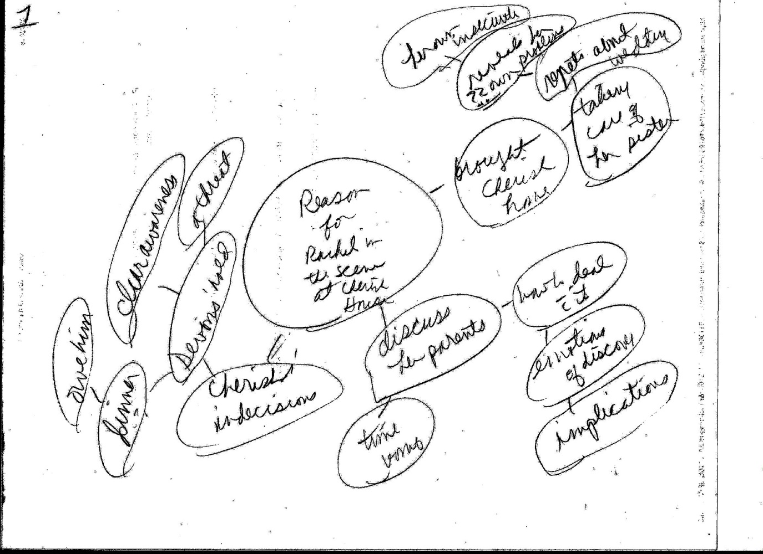

Slide 12
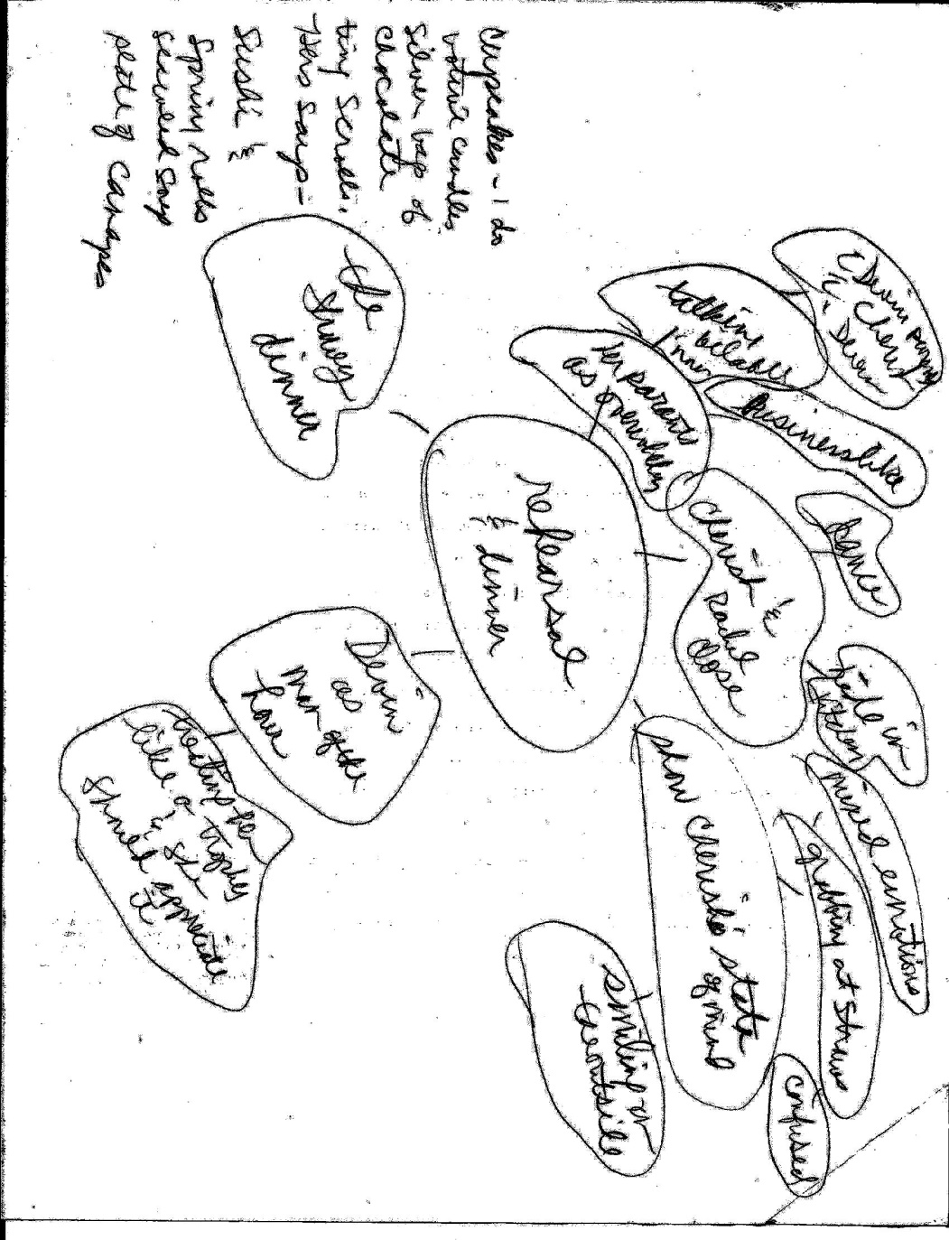

Slide 13
Effective Scenes
Essential Elements:
plot point
character’s goal
action that advances the plot or heightens tension
Important Elements:
character development, a cause of character conflict
an effect of character development
raise stakes
reinforce stakes
character motivation
Bonus Elements:
character backstory
world building
tone
theme
foreshadowing
http://blog.janicehardy.com/2012/01/fundamental-check-do-your-scenes-have.html

Slide 14
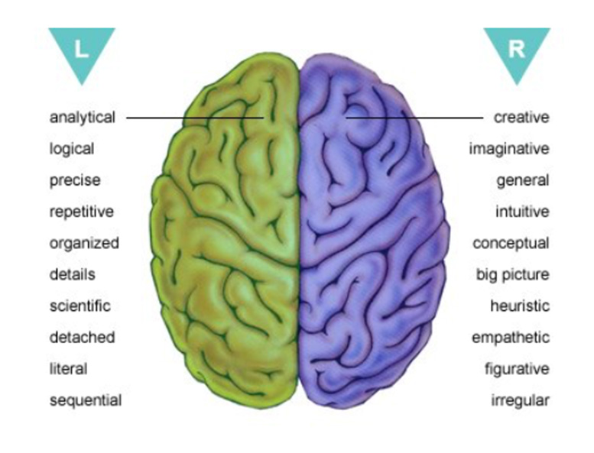
Brain Power

Slide 15
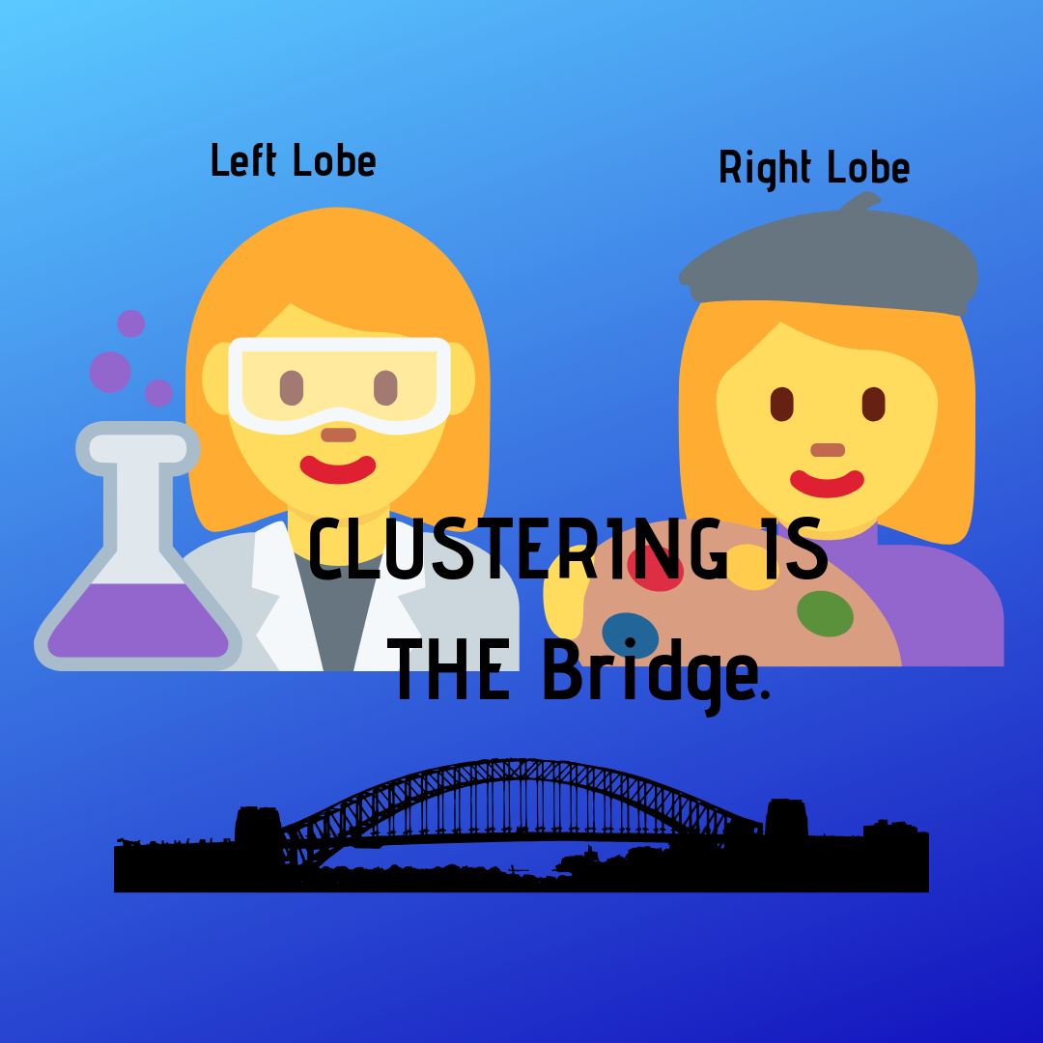
“In effect, the left-brain is a scientist, the right-brain an artist.” Roger Sperry, Pulitzer Prize winning brain research scientist.

Slide 16
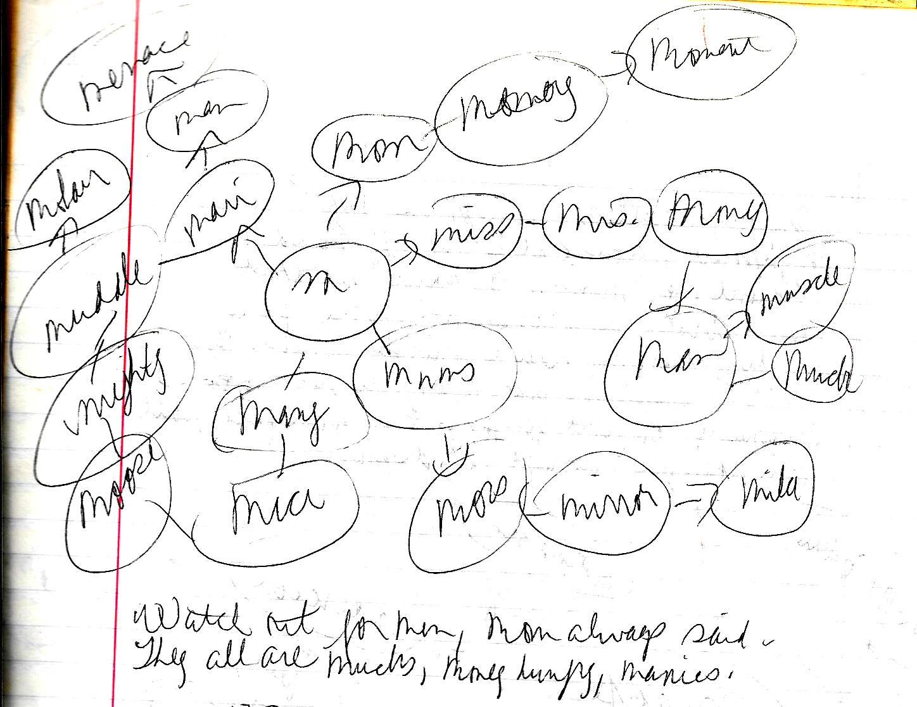

Slide 18
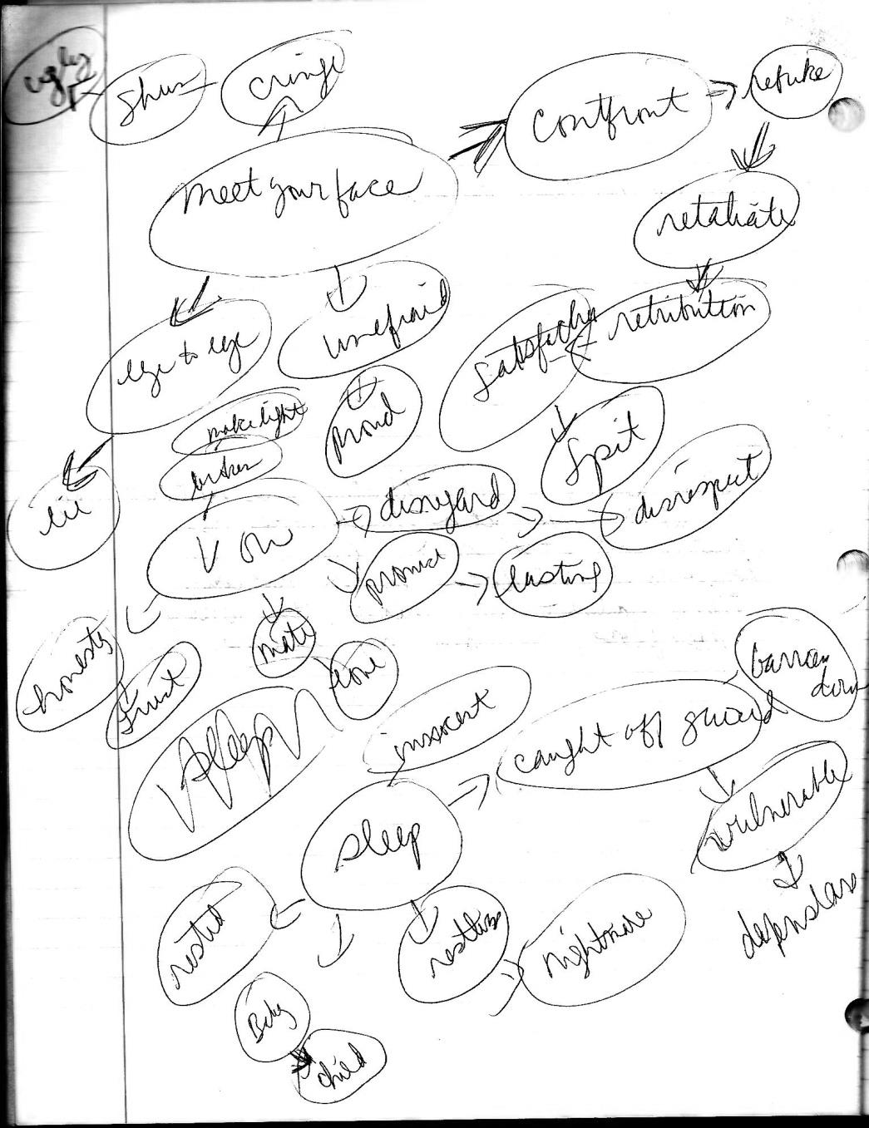
In my restless sleep, in my nightmares, you catch me off guard and haunt my mind. It angers me that you broke a promise and were far less than my naïve mind knew. But what angers me far more is that I continually confront you and spit in your face, but only when you disrupt my dreams.

Slide 19
Tips
Wonder
Accept
Feel
Write

Slide 20
Wonder
Wonder bypasses the need for the right answer. Wonder elicits curiosity, intuition, active mind. There is no logic or right or wrong when you’re in a state of wonder. Open yourself to the bliss of wonder: I wonder what color the sound of a raindrop evokes. I wonder what it’s like to look up into the sky and see three moons. Is each one a different color? Does that have a purpose or is it simply beautiful?
Wonder facilitates new insights and recognition of a new, possibly exciting pattern that leads to purpose and meaning. Allowing wonder and capturing associations that form a pattern elicits a natural desire to complete the picture by writing. And your right side brain helps you do that. Wonder is so exciting!

Slide 21
Accept
Accept that there is no right or wrong in clustering. You’re just going to try it.
There are no failures.

Slide 22
Feel
Before you start clustering, grab your piece of paper and beloved writing utensil and pause.
Close your eyes. Sit still and breathe deeply, in and out, several times.
Open your eyes and write a focusing word or phrase in the center of your paper. Just write whatever words follow until you feel the shift and recognize a pattern forming and the direction to write in. Notice that happening. It will.
Don’t think about it, feel it.

Slide 23
Write
Don’t engage your left brain by thinking. Trust your insights and just WRITE!

Slide 24
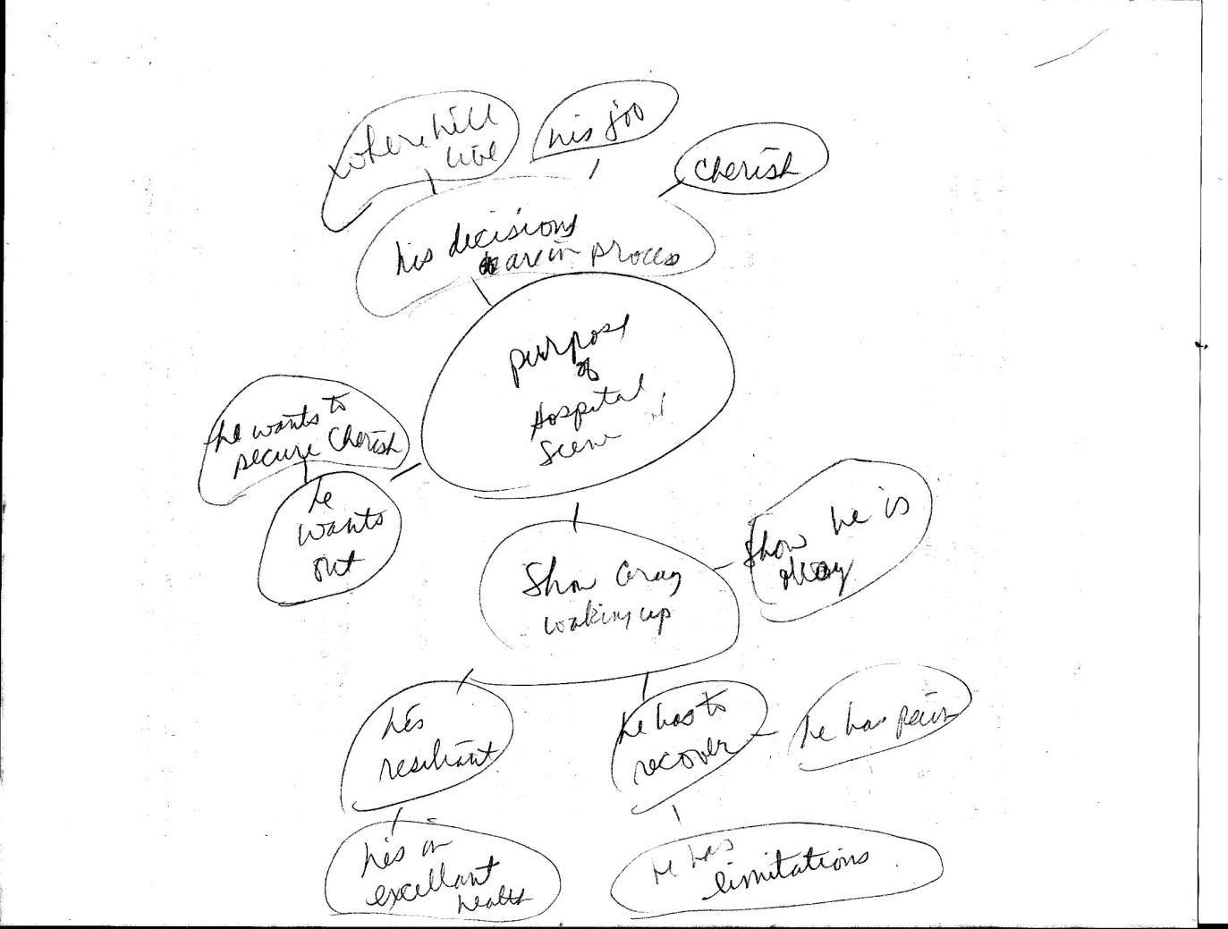

Slide 25
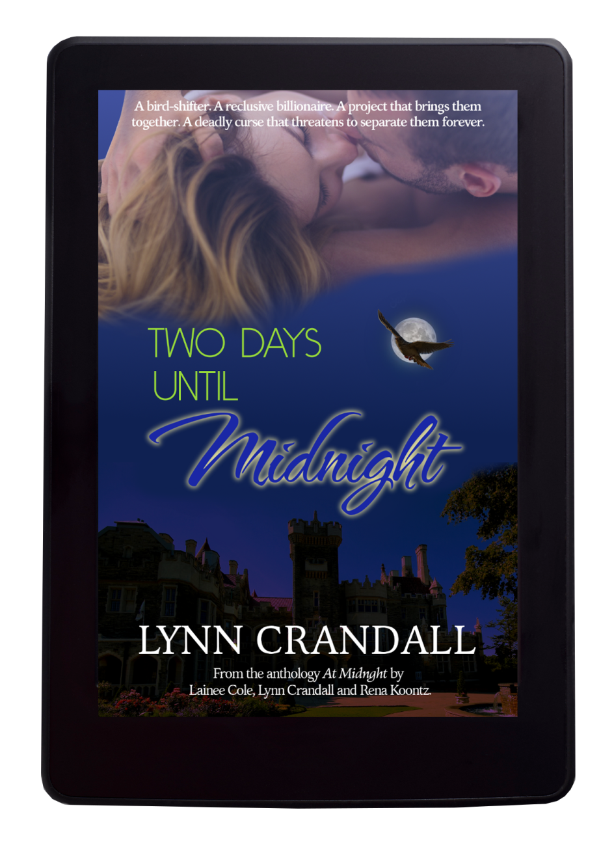

Slide 26
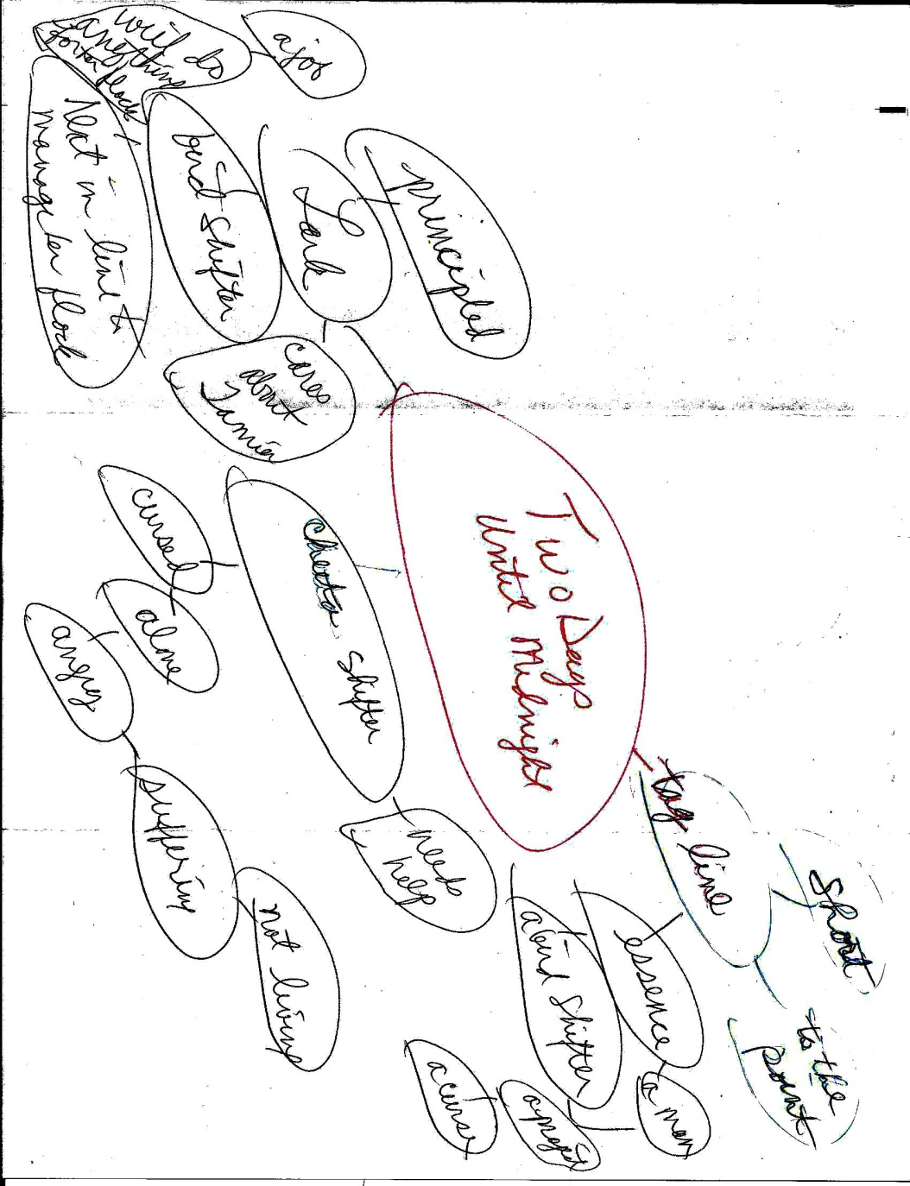

Slide 27
A bird shifter. A reclusive billionaire. A project that brings them together. A deadly curse that threatens to separate them forever.

Slide 28
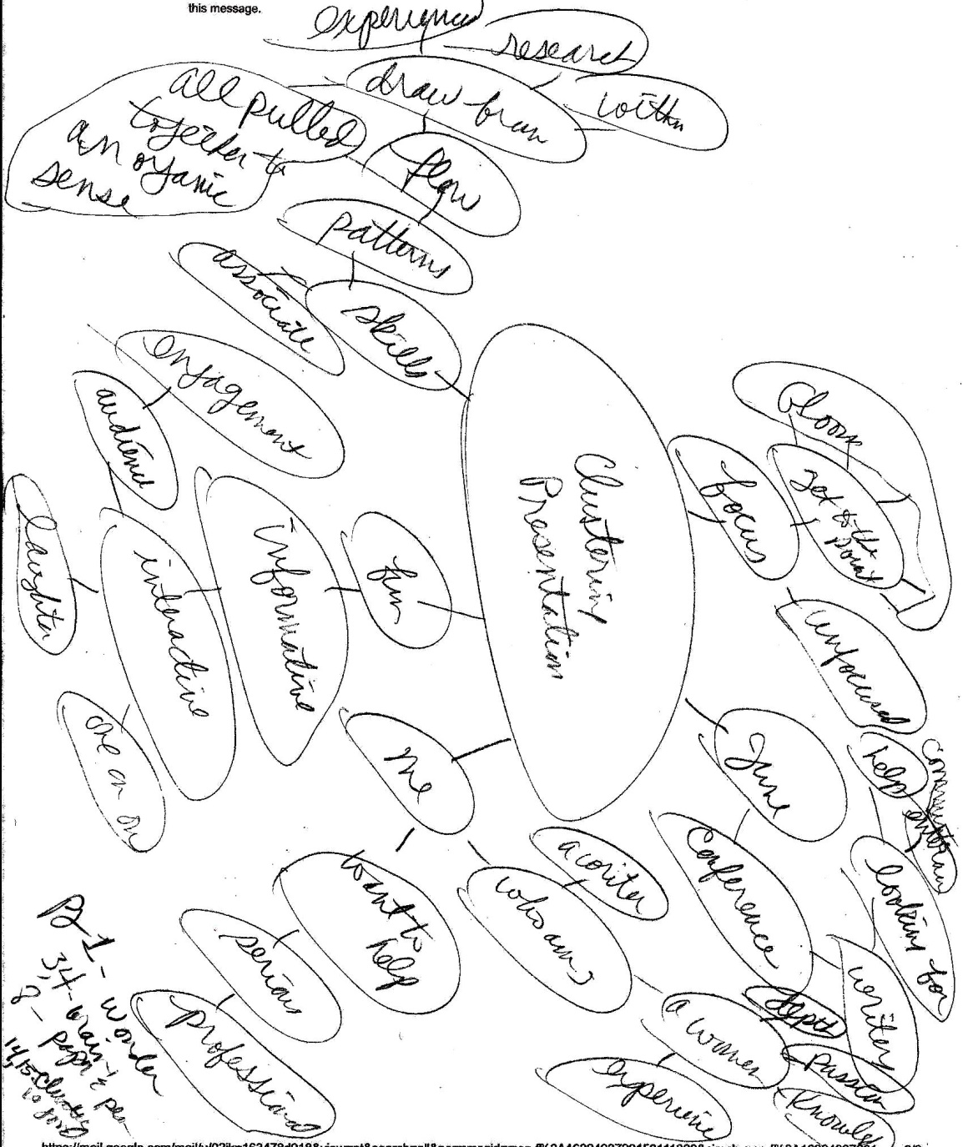
Who I am –a writer, want to help
My Purpose – provide useful tools, engagement
For Authors – interaction, improve, fun, laugh, community

Slide 29
Quick Replay
What is clustering? It is a tool that quiets the inner censor and engages the creative aspect of the brain.
What can be done with clustering? Clarify your writing and get to the point.
Why does it work for me? It’s versatile, tactile, accessible.√
Clustered:
Scenes√
Vignettes √
Taglines√
Emails√
Poetry √
√
√
√

Slide 30
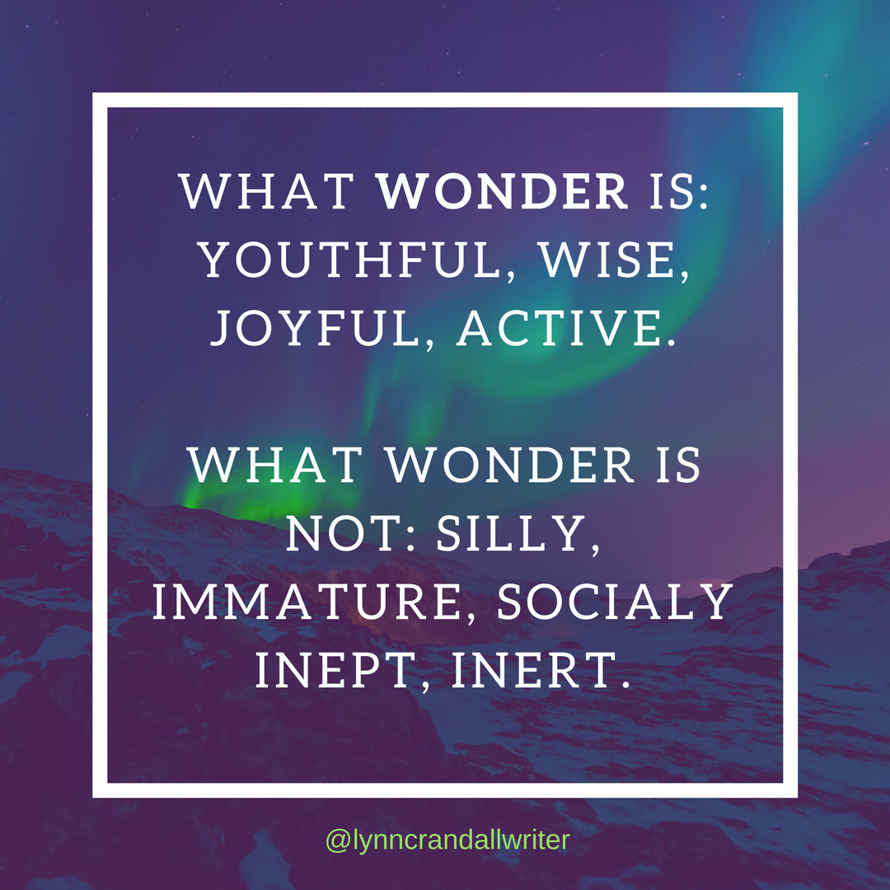
“Central to natural writing is an attitude of wonder.” Gabriele Rico, Ph.D., author of Writing the Natural Way.

